Slide 1
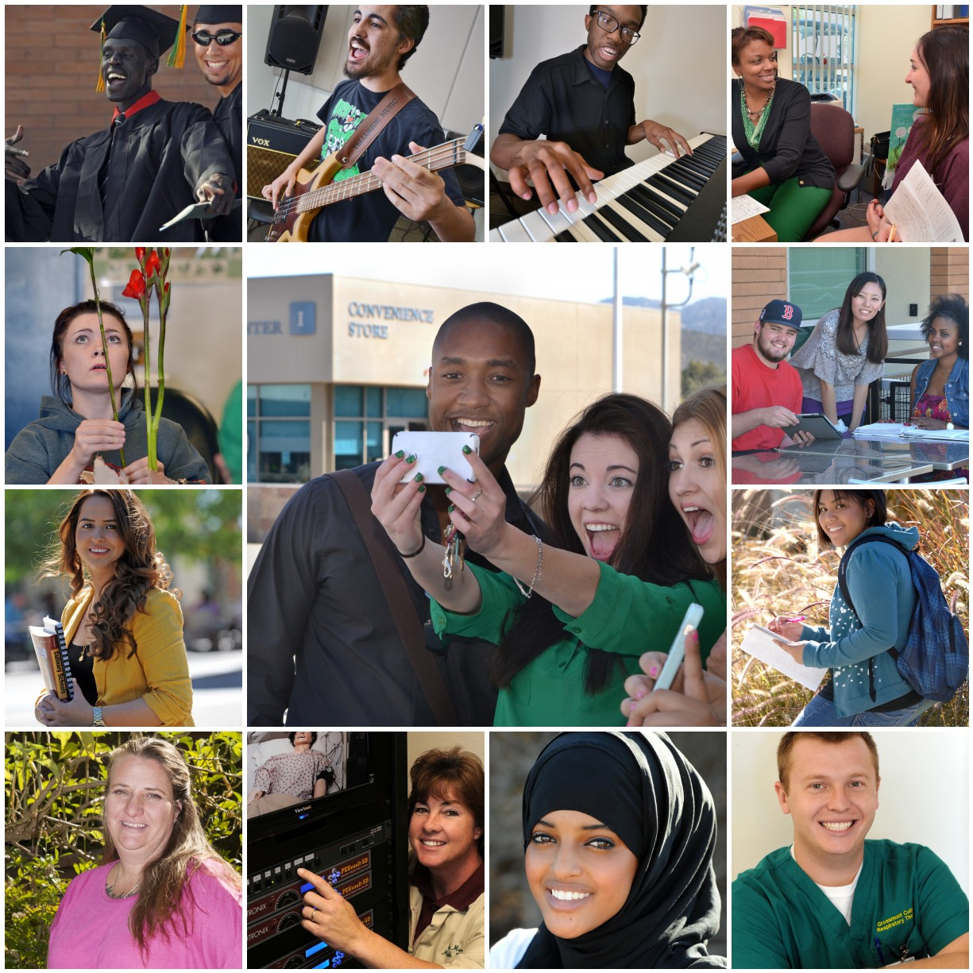

Diversity, Equity & Inclusion
Summit
May 5, 2014

Slide 2
Diversity, Equity & Inclusion Summit
AGENDA
        12:30 – 1:00 Lunch & Sign-in
        Committee Reports – Highlights of the Past Year
        1:00 – 1:15 Dr. Miles
            Celebrating Accomplishments
            Defining Relationships
            Reviewing Our Vision
        1:15 – 2:00 Marsha Edwards – “The Big Why of DEI”
        Our Esteemed Student Panel
        2:00 – 2:10 Break
        2:10 – 4:00 Chris Tarman and Anne Krueger
            Where are we now?
            The Pursuit of Excellence
            Where do we want to go?
            How will we know when we arrive?
            How will we measure success in the short- and long-term?
        4:00 – 4:45 Raad Jerjis - Cultural Competency Exercise
        4:45 – 5:00 Dr. Miles - Closing Remarks

Slide 3
Before…
Staff Diversity committee
Equal Employment
Opportunity Committee
College Accessibility
Committee
Academic Accommodation
Review Committee
Student gender
equity committee
ADA Committee
Notes:
AGUSTIN

Slide 4
After…
Diversity, Equity and Inclusion Council
Cuyamaca College
DEI Committee
District Services
DEI Committee
Grossmont College
DEI Committee
Notes:
AGUSTIN

Slide 5
DEI Charge
Our OBJECTIVE is to provide a welcoming environment that fosters cultural competence, equity, and respect for all employees and students.
The council is RESPONSIBLE for assessing progress and disseminating information regarding diversity and equity; recommending meaningful strategies for improvement; overseeing the implementation of the charge districtwide; and ensuring compliance with relevant laws and regulations.
The council is also RESPONSIBLE for writing plans in accordance with Title 5 or other federal and state regulations and the District’s Commitment to Diversity. The council also serves as the District’s EEOC Advisory Committee.
The Council PROMOTES acceptance of all people, including those of diverse age, ancestry, color, disability, ethnicity, perspective, national origin, religion, gender, gender identity, sexual orientation, education, socioeconomic, and employment status.
The GOAL of the council is to create an inclusive environment in the Grossmont-Cuyamaca Community College District and to honor the importance of differences in others.
Notes:
AGUSTIN

Slide 6
DEI Accomplishments

Slide 7

American Council on Education
August 2011- April 2013

Slide 8
A DEI Strategic Plan
Student Access, Equity and Success – Ensure that students of all backgrounds feel welcomed and succeed in equal rates
Cultural Competency & Culture of Inclusion – Enhance cultural and global competencies for students and employees
Communication – Communicate and inform the college district and community about DEI and related activities
World-Class Workforce – Diversify our workforce by enhancing hiring practices and providing support and development for all employees
Notes:
ANNE

Slide 9

Student Access, Equity
and Success
Established gender-neutral restrooms
Established contemplation rooms
Notes:
NANCY

Slide 10
Cultural Competency & Culture of Inclusion
Diversity Dialogues
Professional development workshops
Notes:
NANCY

Slide 11

Created a Safe Spaces Program
for LGBT students
Notes:
NANCY

Slide 12

Wrote DEI Strategic Plan
Created DEI websites for District, Grossmont and Cuyamaca
Includes diversity activities in monthly email newsletter to community
Media releases about diversity events
Notes:
ANNE

Slide 13
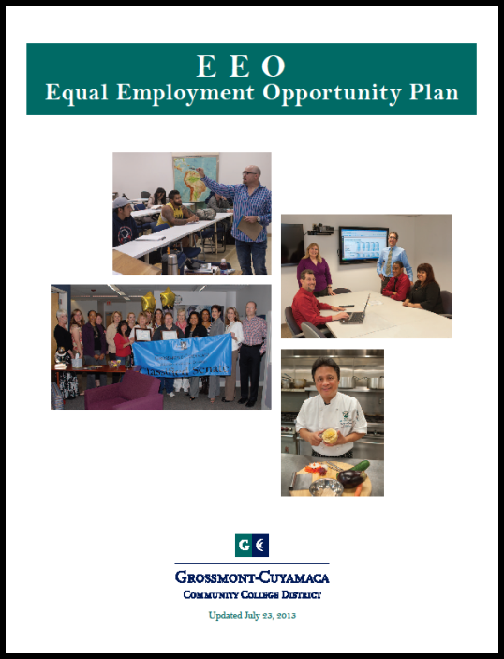
Develop a world-class
workforce
Updated GCCCD
Equal Employment Opportunity handbook
Notes:
ARLEEN

Slide 14
Bring attention to diversity gaps
Identify and promote diversity in the curriculum
Include DEI in new employee onboarding
Hold workshops on use of language about diversity, equity, inclusion
Promote cultural competency for students and employees
Create a DEI leadership award
?????
Next STEPS
Notes:
AGUSTIN

Slide 15
Our Esteemed Student Panel
Richard Arias, LGBT Club (Cuyamaca)
Esau Cortez, ASGC, Inc. President (Grossmont)
Ariel La Madrid, Foster Youth (Cuyamaca)
Riyam “BG” Mansoor, EOPS & Interclub Council (Grossmont)
Chad Peterson, Student Veteran’s Organization (Cuyamaca)
Simone Robbins, Native American Student Alliance (Cuyamaca)
Frankie Rojas, Veterans Student Associate (Grossmont)
Thadius Sanders, DSPS (Cuyamaca)
Zayde Zazueta, EOPS (Cuyamaca)

